Slide 1

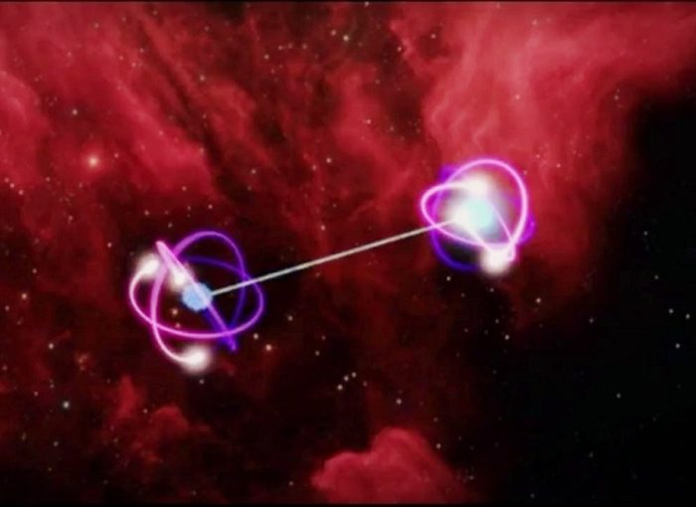
The unexplained nature——
Quantum Entanglement
Mingda Li

Slide 2
The unexplained nature
" Nobody understands quantum mechanics. "
—— Richard Feynman
"If you think you understand quantum mechanics then you don't understand quantum mechanics“
—— Richard Feynman

Slide 3
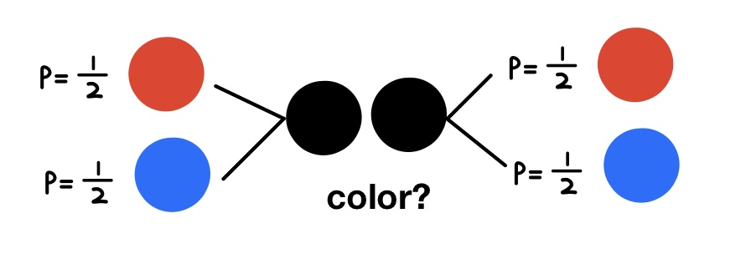
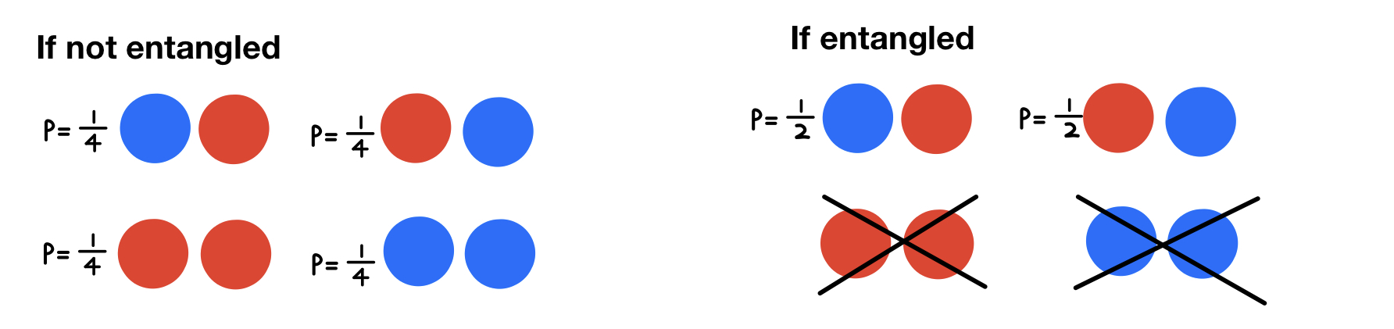
What’s quantum entanglement ?
If not entangled, 4-kinds If entangled, 2-kinds.
intuitive count-intuitive
Notes:
For example, let’s guess there are two balls, and every ball has 50% chance to be red, and the other 50% chance to be blue.
I draw them black because we don’t know what are the colors of the two balls.

Slide 4
What’s quantum entanglement ?
If two systems are entangled, then they will have a magic relation.
That’s: if the first is red, then the second must be blue!
It looks like the two balls keeping talking with each other×
It looks like they can exchange information with each other×
It violates the Special Relativity（狭义相对论）.

Slide 5
What’s quantum entanglement ?
It’s still an enigma!
Einstein said the quantum entanglement is “spooky action at a distance”
Physics is developing very fast, I believe there will be a perfect explanation one day!

Slide 6
Thanks!

